Slide 1
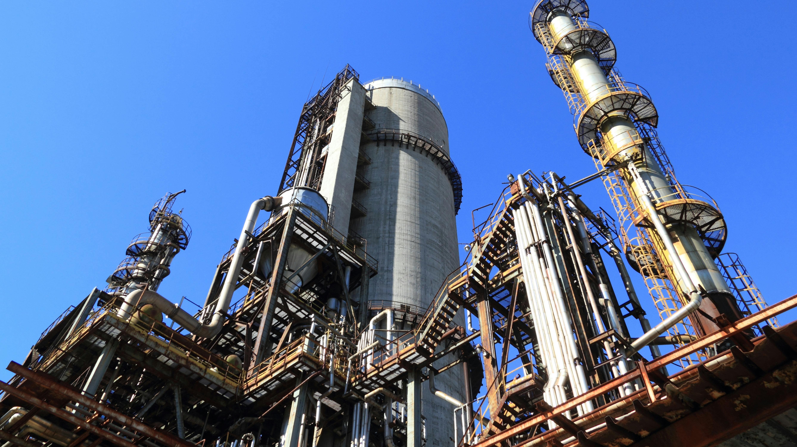

Process Intensification in Petroleum Refining
Abstract
Petroleum refining traditionally consists of energy intensive stages in multiple large-scale units for separation, conversion, and treatment which produce high carbon emissions. Process Intensification (PI) seeks to reduce the equipment size and energy consumption and other factors of traditional processes to improve refinery efficiency. Furthermore, given the Oil and Gas industry is notorious for consuming non-renewable energy resources, it is quite important to find methods which minimise its impact. In this paper, different techniques combining reaction and separation to simplify the equipment used in these stages and therefore the number of steps taken in a refinery were reviewed, such as Membrane Reactors (MR) for hydrogen production, and Reactive Distillation (RD) for fuel upgrading. Despite these techniques still being in the early research and development stages, they represent a shift toward smaller and efficient refineries suitable for a low-carbon future.
Notes:
Hey guys my presentation is on ....
typically

Slide 2
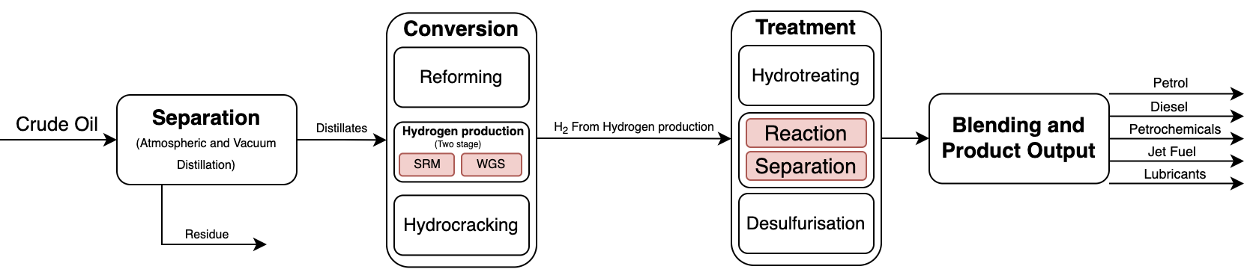
Process Intensification (PI) in refining
Process intensification is defined as the development of novel apparatuses and techniques that, compared to those commonly used today, are expected to bring dramatic improvements in manufacturing and processing, substantially decreasing equipment-size/production-capacity ratio, energy consumption, or waste production, and ultimately resulting in cheaper, sustainable technologies. (Stankiewicz and Moulijn, 2000) In refining, PI can be applied through several approaches, including Reaction–Separation Integration, Separation Intensification, Energy Integration, and Process Modularisation. Reaction-separation was chosen as my focus despite all the other approaches because it directly reduces energy use alongside the number of units needed in a refinery, which is more efficient and less modules need to be sourced which reduces both the cost and carbon footprint.
Figure 1 shows the main steps in a traditional refinery, from the start (Crude Oil feedstock) to the different product streams. Note that given there are many different products in a refinery, just the most common ones will be shown. Furthermore, a lot of simplification has been made to the steps to highlight the potential impacts of Process Intensification.

Slide 3
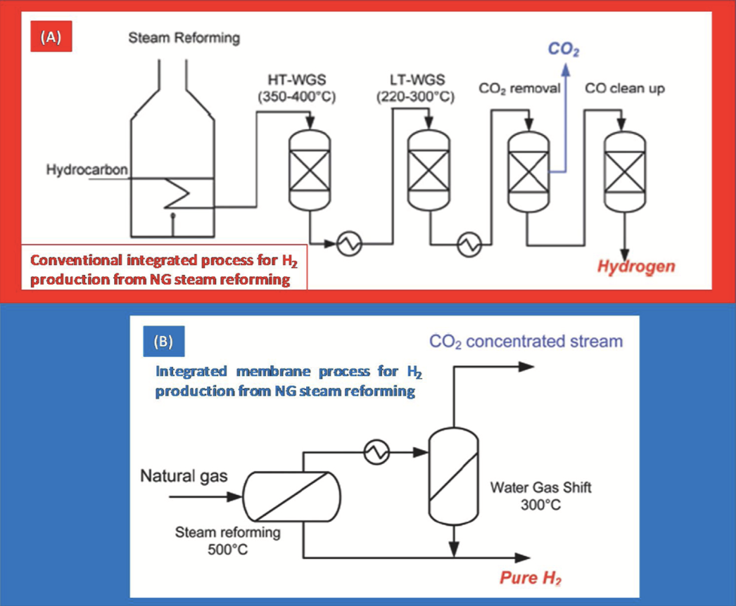
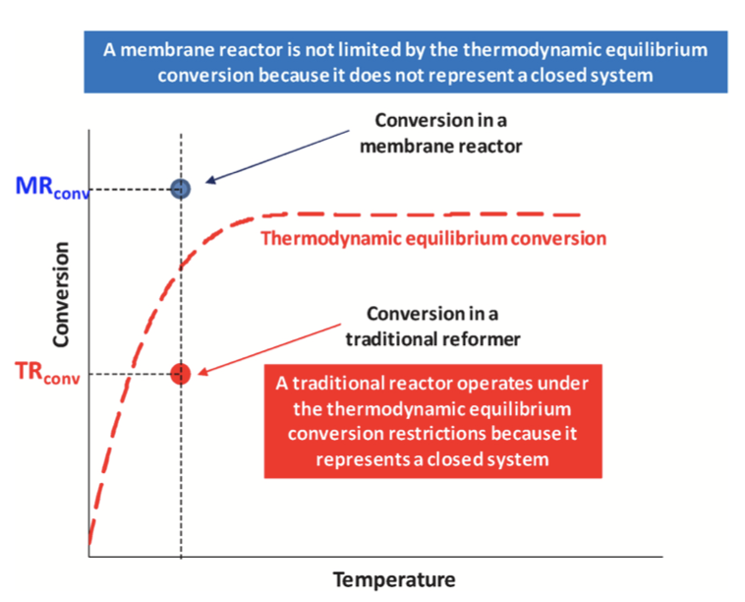
Reaction-Separation Integration: Key Techniques
Reactive Distillation (RD)
Reactive distillation is a technique where chemical reaction and distillation occur simultaneously in the same column, which allows equilibrium-limited reactions to have much higher yields by continuously removing products as they form. (Mahajani and Chopade, 2000) This is extremely relevant to petroleum refining as there are a myriad processes which rely on chemical reactions, and if these reactions can be optimised then corresponding equipment could be designed to take up less space, or use significantly less energy for example.
Figure 2. Scheme of a conventional refinery and a scheme with an integrated membrane system, and a graph showing the conversion of the two
Membrane Reactors (MR)
Membrane reactors combine catalytic reactions with selective product separation. In refining they are often used for hydrogen production and hydrotreating, where because hydrogen is being removed as it is formed, it shifts equilibrium towards making more hydrogen. Developing the right membrane is quite challenging, as having a membrane too thick will result in a lower yield, and having a membrane is too thin will make it prone to fail either mechanically or by contaminating more easily. Also, it is expensive to source catalysts like Palladium (which is the best catalyst of its type) (Amiri, Ghasemzadeh and Iulianelli, 2020). The key technique which both MRs and RD share is removing products as they form to shift the equilibrium towards the products. They both highlight the benefits of PI, optimising performance with less units. Additionally, they feature complex internal structures, however they both differ in the sense that RD uses the differences in boiling points, however MRs use selective transport through a membrane, which is much more intricate. Industrial development in this area has been led by companies such as Haldor Topsoe and Air Products, who are testing membrane-assisted reforming and hydrogen recovery systems to improve efficiency in refinery hydrogen networks (Haldor Topsoe A/S, 2021)

Slide 4
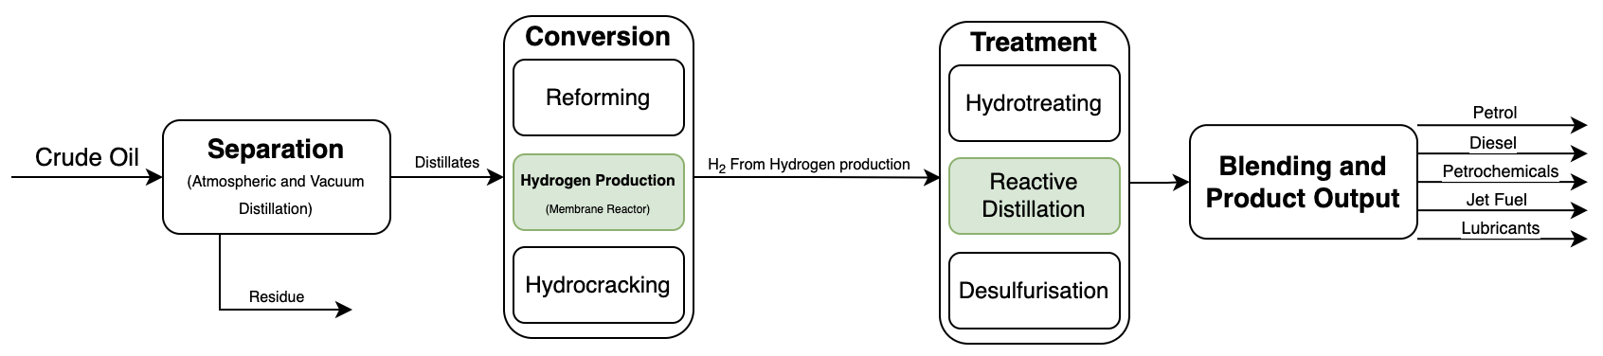
Figure 3. (Potential solution)
Figure 3 shows how these different PI techniques could be integrated into a generic refinery to improve efficiency and minimise wasted energy

Slide 5
Challenges and limitations
However, despite all the positive ways in which these PI techniques could be beneficial, many challenges remain which impede their implementation. One of the primary challenges is limited awareness and understanding as it is a relatively new concept. The low demand, due to a lack of understanding of its potential causes low investment into the vital research and development. Since investment can only be obtained when there is enough interest, this vicious cycle means progress can only be very slow. Additionally, because it is in the very early stages, a lot of further testing will need to be done to pinpoint its effectiveness at a commercial scale. This is because new technologies not only need to pass tests in the lab, but they must also pass government regulations and slowly be eased into industrial applications before they can be produced at a large scale.
Future Outlook
As the energy industry transitions towards lower-carbon fuels, Process Intensification could play a key role in creating smaller, modular, and cleaner refineries to adapt. Reaction-Separation technologies such as RD and MR allow emissions to be decreased alongside reducing energy input, while also maintaining high product quality.
Conclusion
Process intensification represents a great opportunity to improve refinery efficiency by combining processes which were traditionally separate. Techniques such as Reactive Distillation and Membrane reactors simplify refinery operations, reduce energy consumption and support emission-reduction goals. However, achieving these benefits at industrial scale depends on further research, cost reductions, and wider adoption across the refining sector.

